Slide 1
Digital System Design CE 325 L1 SPRING 2024
Instructor : Dr. Syed Arsalan Jawed
Associate Professor of Practice
arsalan.jawed@sse.habib.edu.pk
Room : W-301
Office Hours : Monday 0930-1030, Wednesday 1430-1530, Friday 0930-1030

Slide 2
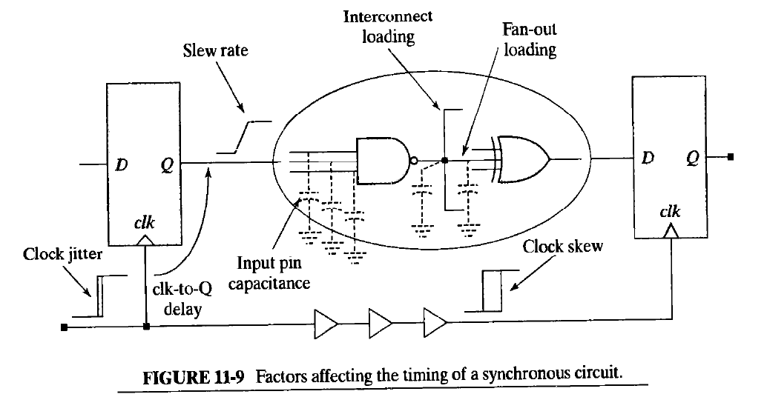
Post Synthesis Design Tasks Chapter 11, will come to chapter10 after it
Factors that affect timing

Slide 3
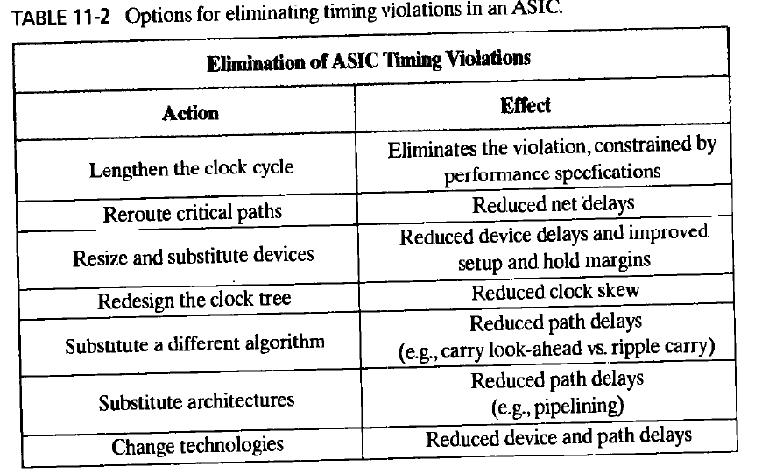
Elimination of Timing Violations

Slide 4
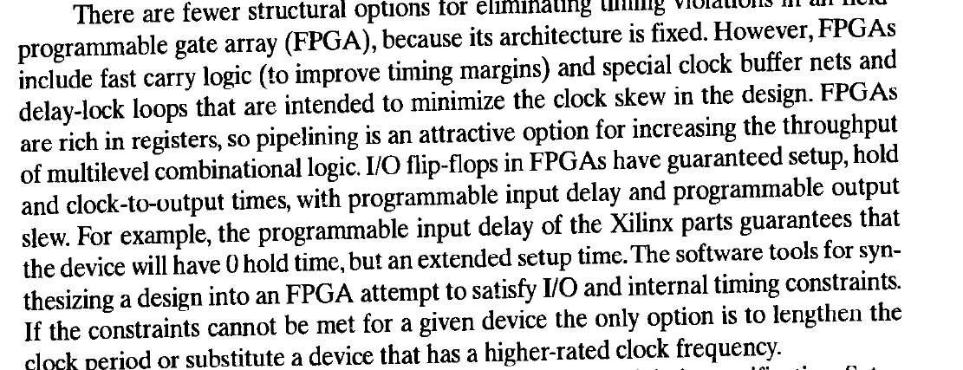

Slide 5
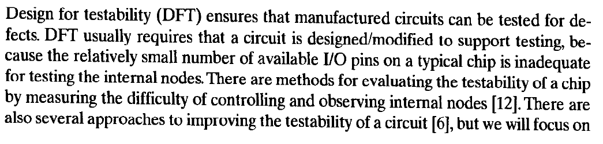
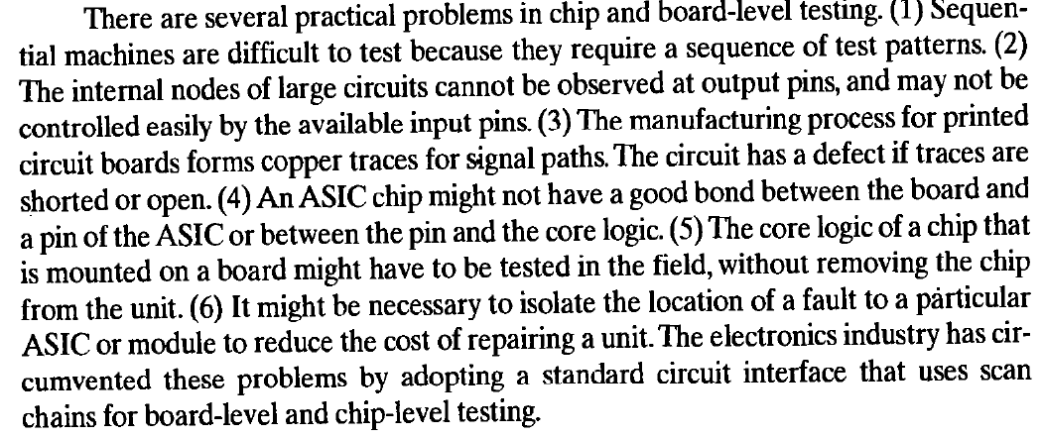
JTAG Ports and DFT

Slide 6
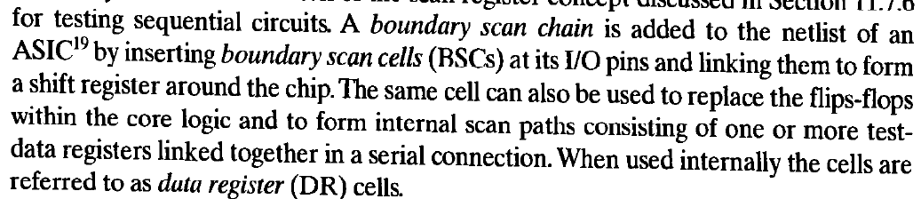
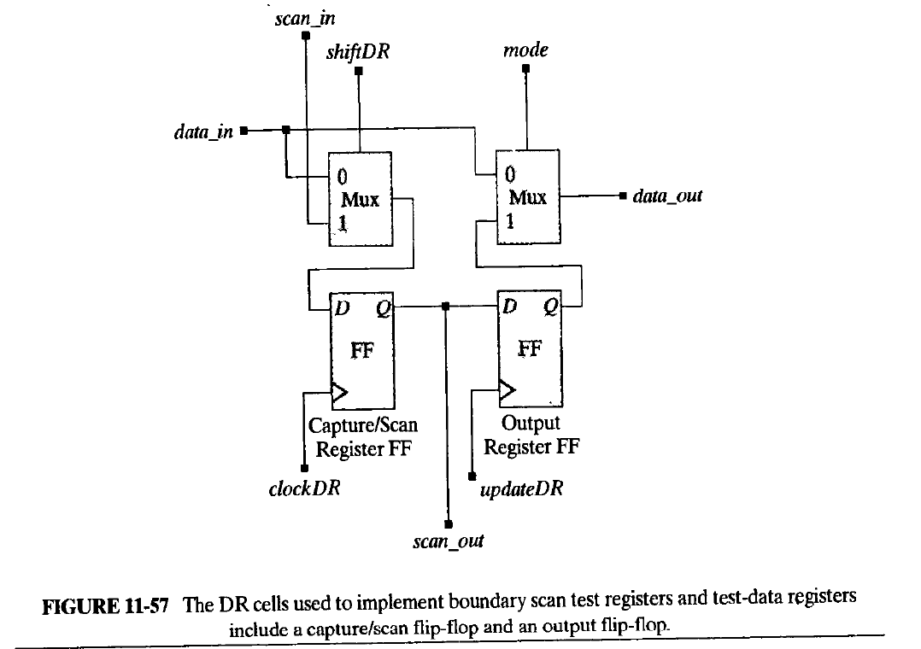
Boundary Scan

Slide 7
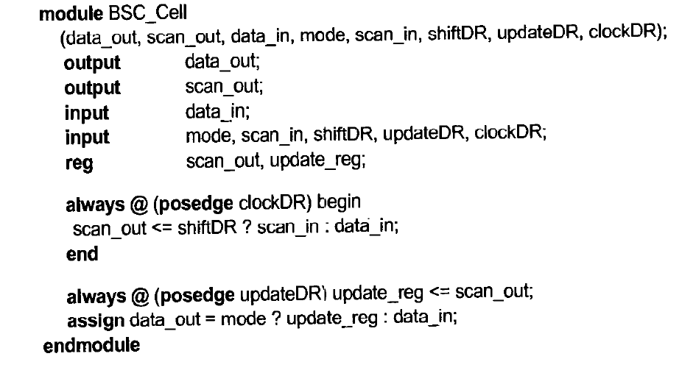

Slide 8
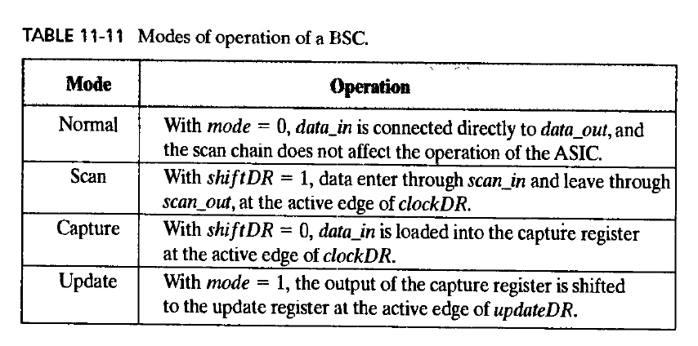
JTAG Modes of Operation

